Slide 1
ISyE 6414: Regression Analysis Project Predicting the diagnosis of Coronary Artery Disease using Statistical Models
Raj Desai (GTID: 903575149)
Sukanya R. Iyer (GTID: 903622016)
Tushar Vende (GTID: 903590888)
Date: April 11, 2021

Slide 2
Objectives of the Project
Assess the efficacy of various simple clinical factors in predicting a possible occurrence of a heart disease in a patient.
Contrasting various statistical models to decide the best model for predicting presence of a heart disease based on simple clinical factors.

Slide 3
Introduction
Heart disease is the leading cause of death in the United States, causing about 1 in 4 deaths. The most common type of heart disease is coronary artery disease (CAD), which can lead to heart attack.
Heart disease is one of the biggest causes of morbidity and mortality among the population of the world. These diseases take an economic toll, as well, costing our health care system $214 billion per year and causing $138 billion in lost productivity on the job.
A heart disease prediction system can assist medical professionals in predicting heart disease based on the clinical data of patients. Early prediction of a possible heart disease will lead to better decision making for a clinical treatment.

Slide 4
Data Description
We utilized Cleveland Heart Disease data from UCI Machine Learning Repository.
Feature | Description
Age | Age in years
Gender | 1 = male, 0 = female
Chest Pain Type (cp) | 1 = typical angina, 2 = atypical angina, 3 = non-anginal pain, 4 = asymptomatic
Resting Blood Pressure (trestbps) | In mm Hg on admission to hospital
Cholesterol (chol) | Serum cholesterol in mg/dl
Fasting Blood Sugar (fbs) | Fasting blood sugar >120 mg/dl, 1=true, 0=false
restecg | Resting electrocardiographic results, 0 = normal, 1 = ST wave abnormality, 2 = showing probable hypertrophy
Max Heart Rate (thalach) | Maximum heart rate achieved
Exercise Angina (exang) | Exercise induced angina, 1=yes, 0=no
Old Peak | ST depression induced by exercise relative to rest
Slope | Slope of peak exercise ST segment, 1 = upsloping, 2 = flat, 3 = down slopping
Number of Major Vessels (ca) | Number of major vessels
Thal (thalassemia) | 0 = normal, 1 = fixed defect, 2 = reversable defect
Target (Diagnosis) | Heart disease diagnosed, 1 = yes, 0 = no (target variable)
Notes:
The data is collected by the V.A. Medical Center, Long Beach and Cleveland Clinic Foundation: Robert Detrano, M.D. Ph.D. The data contains 303 patients and 14 attributes that are useful to predict heart disease.

Slide 5
Exploratory Data Analysis
The dataset comprises 303 samples and each of them has 14 characteristics. There are 13 predictors and one target variable.
EDA typically detects errors, finds appropriate data, checks assumptions, and determines the correlation among the explanatory variables.
It enhances the insight into a given dataset and identifies anomalies.
We split the 13 characteristics into two categories, 6 of them as numerical and rest 7 as categorical.

Slide 6
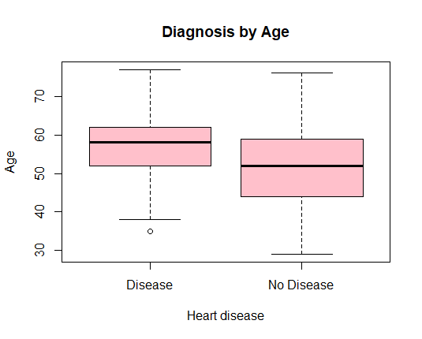
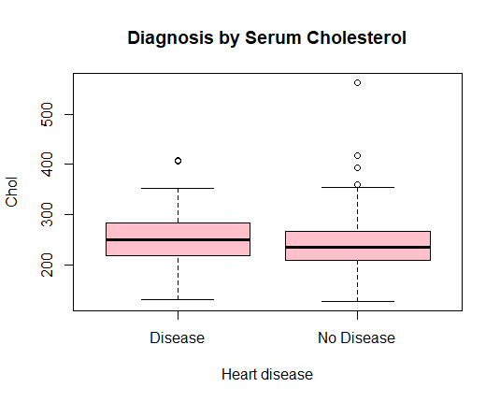
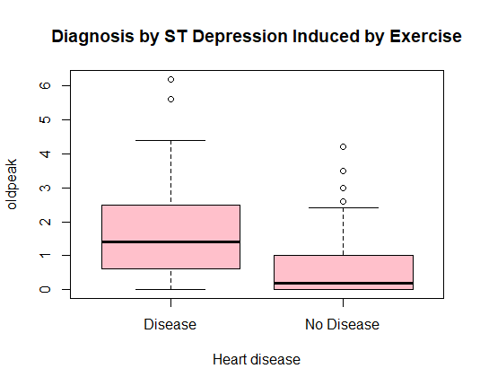
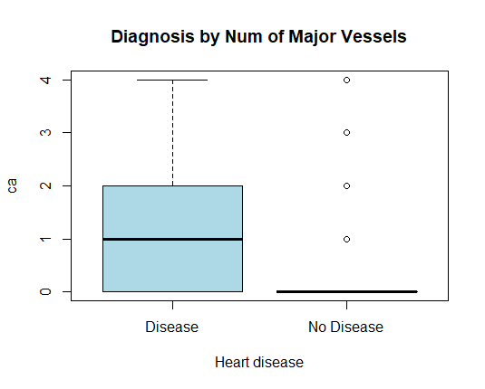
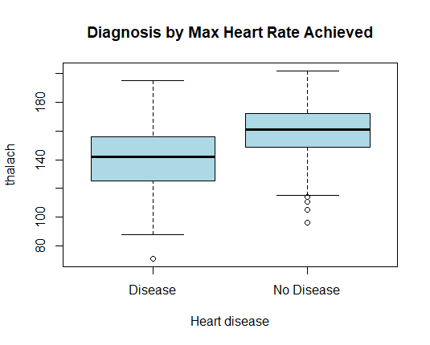
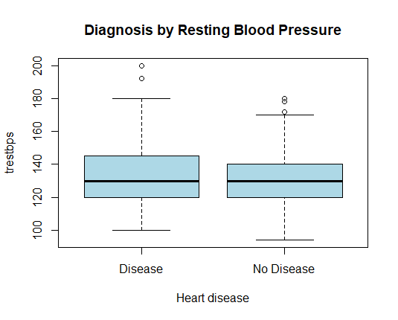
Exploratory Data Analysis – Numerical Features
The box plots display the distribution of the numerical features for the presence and absence of the disease. Resting blood pressure, cholesterol, oldpeak and number of major vessels are observed to be higher for heart disease patients.
Figure 1: Numerical features & heart disease analysis

Slide 7
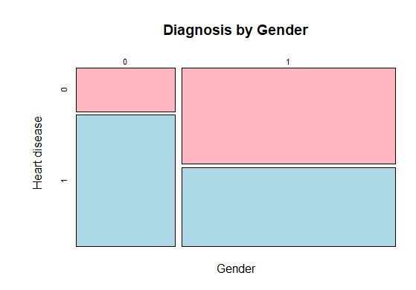
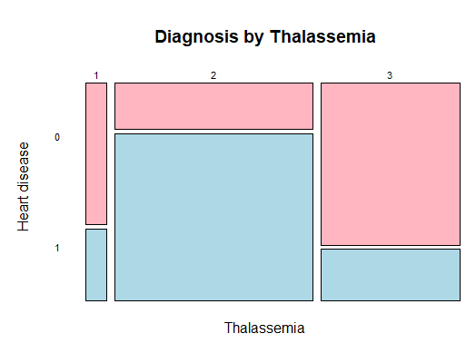
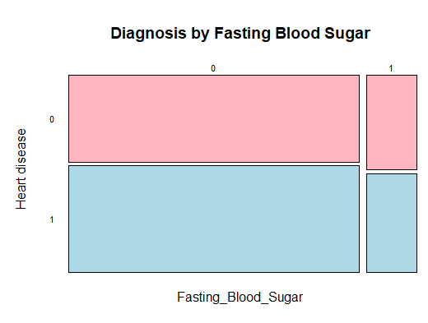
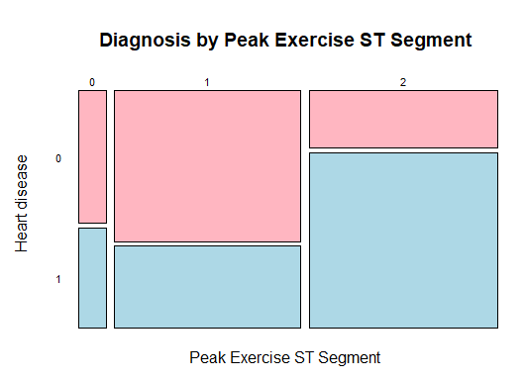
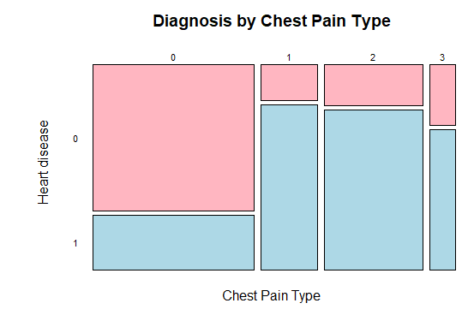
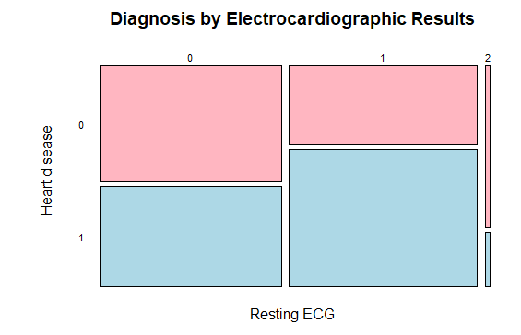
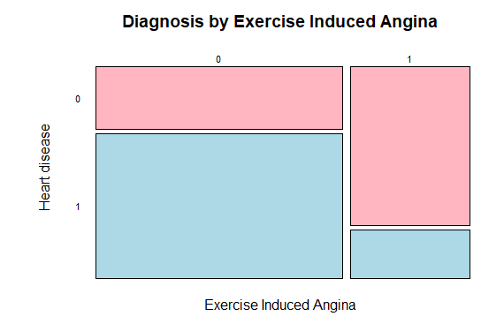
Exploratory Data Analysis – Categorical Features
The mosaic plots help in visualizing the statistical association between two variables. Features having increased prevalence of heart disease are asymptomatic angina chest pain, presence of exercise induced angina, lower fasting blood sugar, peak exercise ST segment, male, higher thalassemia score.
Figure 2: Categorical features and heart disease analysis

Slide 8
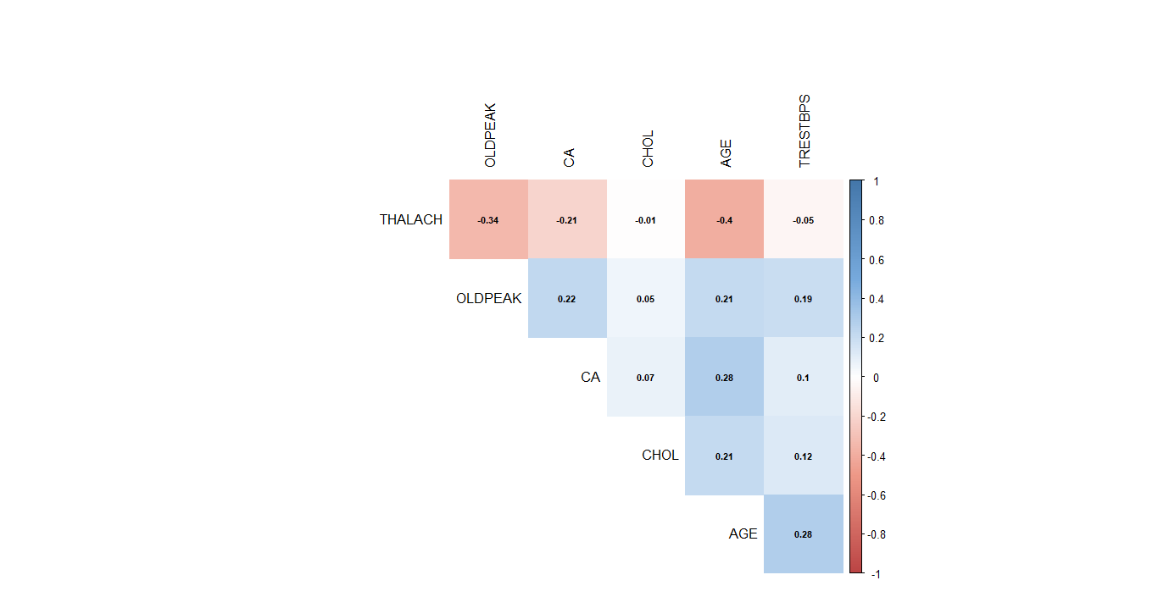
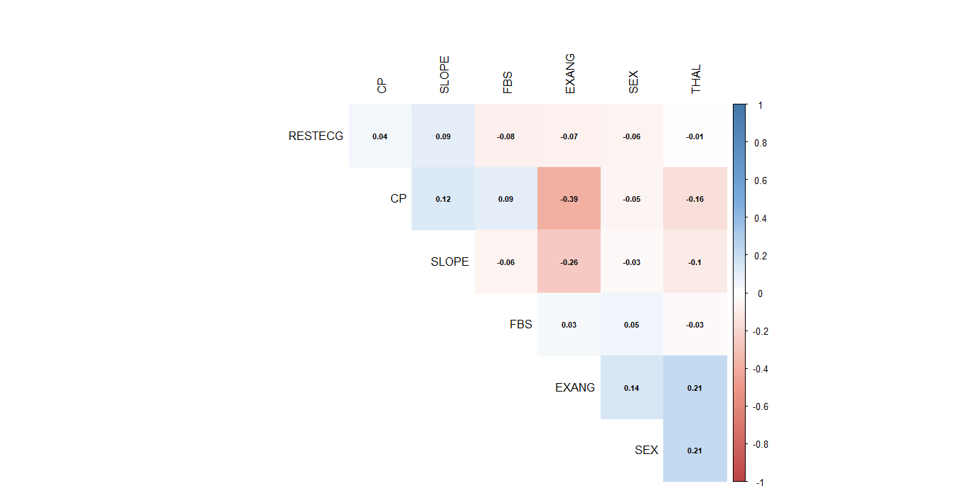
Correlation Matrix
To observe the statistical correlation among the numerical and categorical features we used correlation matrix.
The matrix refers to the degree to which a pair of variables are linearly related.
Figure 3: Correlation matrix for Numerical features
Figure 4: Correlation matrix for Categorical features

Slide 9
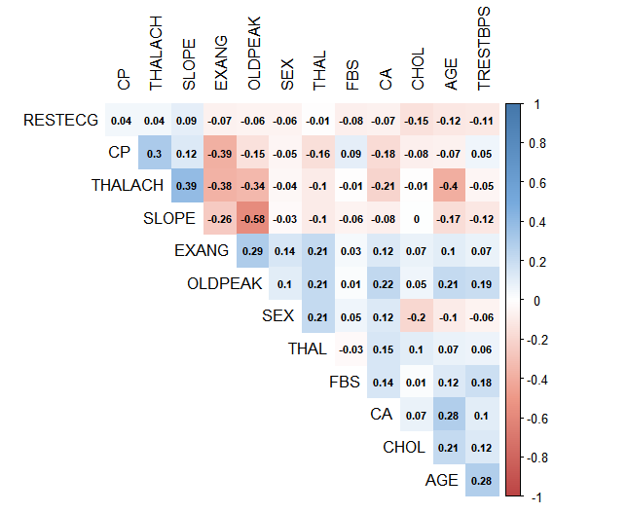
Correlation Matrix
From the correlation matrix, we find that some features are strongly correlated, in this way, we conclude that we do not need to put all variables into the prediction models.

Slide 10

Model Selection
In presence of multiple parameters, it is important to select the best model.
p predictor variables result in total 2^{p} models. There are total 13 predictor variables in our dataset which will result in 2¹³ = 8192 candidate model. If we consider the interaction between parameters, this number will be even larger.
Hence, to select a model, we need
A criterion to assess the models
A search strategy
Assessment Criteria | Search Strategies
Sum Square Error | Best Subset Algorithm
R² Adjusted | Stepwise Search
Mallow’s Cp
Information Criteria: AIC or BIC
Cross Validation: LOOCV or GCV

Slide 11
Model Selection Methods
We have used following model selection methods:
Best Subset Algorithm using Mallow’s Cp criteria
Stepwise Search using AIC (Akaike’s Information Criteria)
Penalized Least Square methods
Ridge Regression
LASSO

Slide 12
Best Subset Algorithm using Mallow’s Cp
Best Subset Model Selection compares all possible models using a specified set of predictors and displays the best-fitting models.
We select the best performing models out of these models.
We used leaps() library in R which performs an exhaustive search for the best subsets of the variables for predicting the response.
The model with the minimum Cp value is selected as the best model.
The Model selected with this strategy included 9 predictor variables dropping AGE, CHOL, FBS, RESTEG

Slide 13
Stepwise Search using AIC
Stepwise Search is a method of fitting regression models in which the choice of predictive variables is carried out by an automatic procedure.
In each step, a variable is considered for addition to or subtraction from the set of explanatory variables based on some prespecified criteria
The basic idea of AIC is to penalize the inclusion of additional variables to a model. The lower the AIC, the better the model.
To implement the search strategy, we first created a full model, logitmodel using all the parameters. Using step() function from the MASS library in R, we implemented the search strategy with AIC criteria.
The model selected by this strategy included 9 variables. The predictor variables are dropped are: - AGE, CHOL, FBS, RESTEG

Slide 14
Penalized Least Square methods
When two or more predictor variables are highly co-related to one another, there will be a multi-collinearity in the model.
Shrinkage reduction is one of the methods to overcome the collinearity.
Shrinkage methods are based on subtracting a penalty from the risk, and the penalty is a function of a decay parameter(λ).
The larger the penalising term, the more our model will be simple and inverted. The "shrinkage penalty" becomes small when the coefficients of our estimators are close to 0.
Two special cases of the shrinkage methods are
(i) Ridge Regression
(ii) LASSO (Least Absolute Shrinkage and Selection Operator).

Slide 15
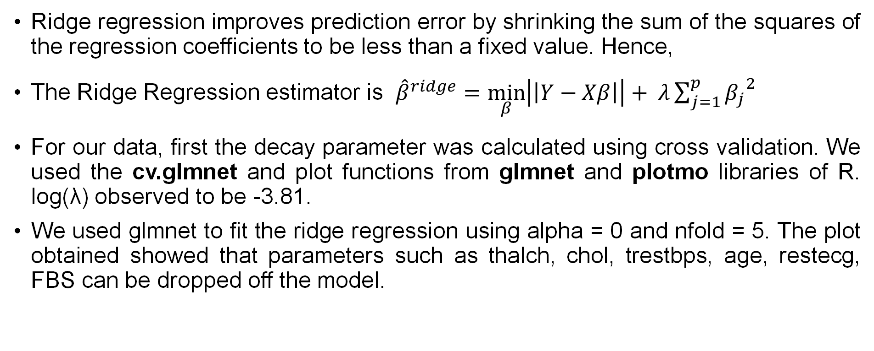
Ridge Regression
Ridge regression improves prediction error by shrinking the sum of the squares of the regression coefficients to be less than a fixed value. Hence,
The Ridge Regression estimator is ${\hat{β}}^{ridge}=$ $\min_{β}\left|\left|Y−Xβ\right|\right|+ λ\sum_{j=1}^{p}{{β_{j}}^{2}}$
For our data, first the decay parameter was calculated using cross validation. We used the cv.glmnet and plot functions from glmnet and plotmo libraries of R. log(λ) observed to be -3.81.
We used glmnet to fit the ridge regression using alpha = 0 and nfold = 5. The plot obtained showed that parameters such as thalch, chol, trestbps, age, restecg, FBS can be dropped off the model.

Slide 16
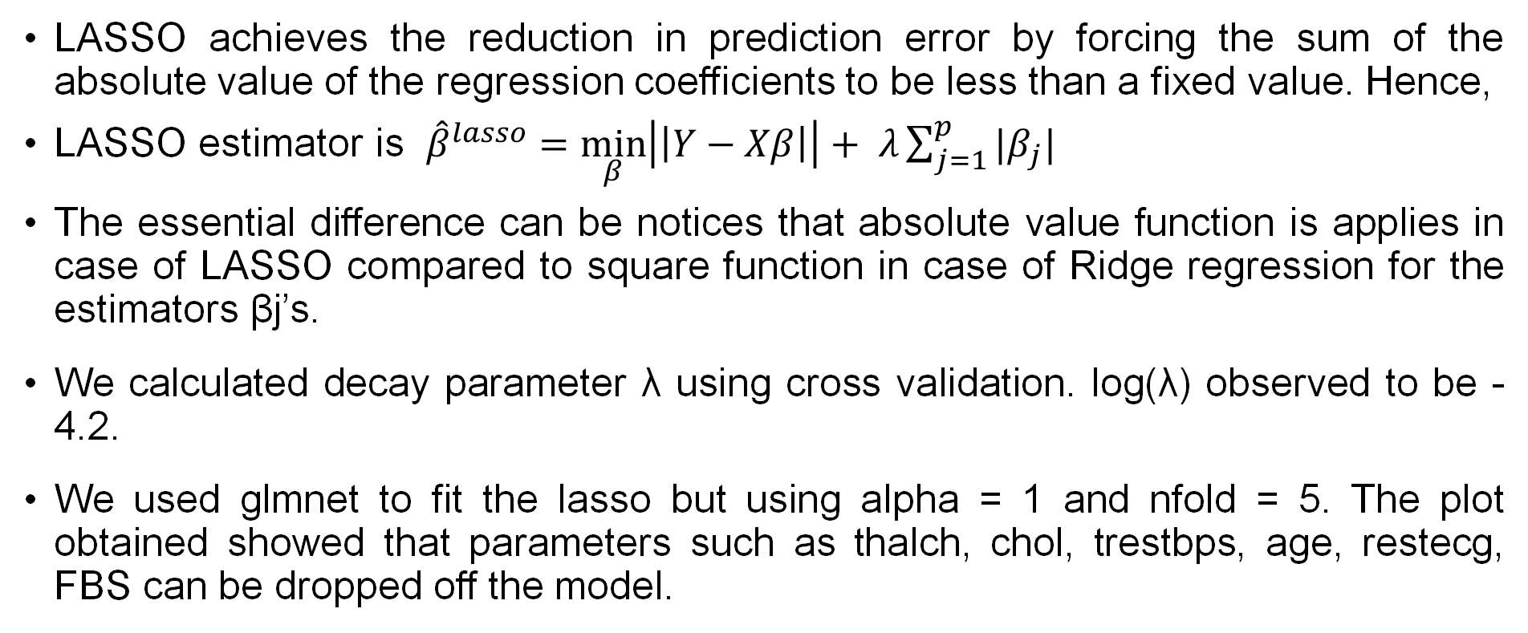
LASSO (Least Absolute Selection and Shrinkage Operator)
LASSO achieves the reduction in prediction error by forcing the sum of the absolute value of the regression coefficients to be less than a fixed value. Hence,
LASSO estimator is ${\hat{β}}^{lasso}=$ $\min_{β}\left|\left|Y−Xβ\right|\right|+ λ\sum_{j=1}^{p}{|β_{j}|}$
The essential difference can be notices that absolute value function is applies in case of LASSO compared to square function in case of Ridge regression for the estimators βj’s.
We calculated decay parameter λ using cross validation. log(λ) observed to be -4.2.
We used glmnet to fit the lasso but using alpha = 1 and nfold = 5. The plot obtained showed that parameters such as thalch, chol, trestbps, age, restecg, FBS can be dropped off the model.

Slide 17
Comparison of Different Models
We use AIC criterion to evaluate the result of different methods of model selection.
The model obtained from stepwise regression includes 9 variables out of 13, except AGE, CHOL, FBS, RESTEG. It has the best AIC value of all the models.
Model Selection Technique | AIC value
Full Model | 181.94
Stepwise Regression | 175.93
Ridge Regression | 180.13
Lasso | 180.13

Slide 18
Model Fitting
Based on the model’s selection methodologies, we made 2 logistic regression models to predict a heart disease possibility based on given predictor variables.
Model 1 : Full model with all 13 predictor variables
Model 2 : A smaller model considering 9 variables with AGE, CHOL, FBS, RESTEG dropped
We randomly placed 25% observations in testing dataset (datatest) and remaining 75% observations in training dataset (datatrain).

Slide 19
Logistic Regression
Logistic regression model fitted using family = binomial and link = logit with the training data.
Then prediction probabilities generated with the testing data and converted to binary prediction by setting a cutoff value for the probability.
If the probability is above the cutoff value, predicted response = 1, otherwise predicted response = 0.
We carried out the logistic regression on both Model 1 and Model 2.

Slide 20
Logistic Regression: Selecting a Cut-off Value
1.) Central cutoff value: Setting cutoff value = 0.5
Though commonly used, it is not very accurate as it ignores the actual distribution of the response variable.
2.) Cutoff value as the proportion of Y = 1 in the training data:
It sets a realistic cutoff on probability of Y being 1 based on the training data.
3.) Best cutoff value from the training data:
We vary the cutoff value between (0,1) in discrete steps of 0.001 and for each value measure the mean prediction error on the training dataset. The cutoff value which minimizes the mean prediction error is finalized.

Slide 21
Logistic Regression: Selecting a Cut-off Value
4.) Using a validation data to choose the cut-off value:
A penalty of "1" is assigned for mis-classifying Ytrue = 0 and a penalty of "2.5" is assigned for mis-classifying Ytrue = 1.
We assign a larger penalty on mis-classifying Ytrue = 1 as minimizing Type II Error is more important (person having an actual heart disease must not be classified as healthy)
We compared the test set prediction results for both the models using the 4 cut-off selection methods suggested above. Model 1 with cut-off value generated using a validation data provided the best results.

Slide 22
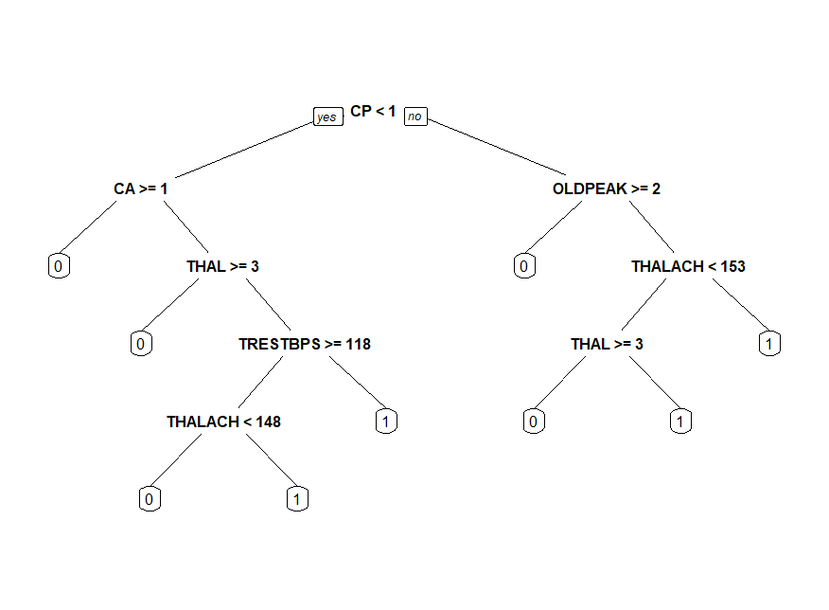
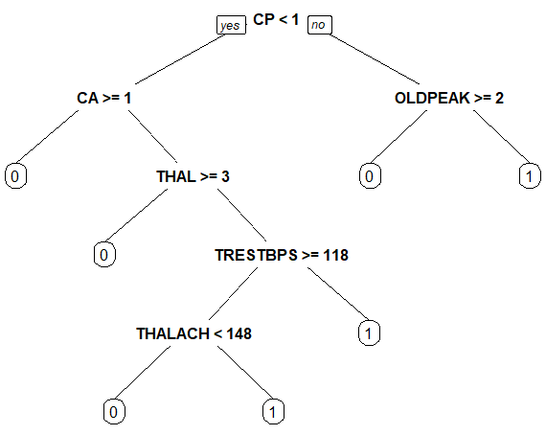
Decision Tree
Decision Trees, a versatile machine learning algorithm is a graph to represent choices and their results in form of a tree.
We used rpart package of the R to obtain the decision tree and confusion matrix for our data.
The prediction error achieved for (i) Model 1 : 18.67% (ii) Model 2 : 21.33%
Model 1
Model 2

Slide 23
K Nearest Neighbors (KNN)
KNN regression is a non-parametric method that approximates the association between independent variables and the continuous outcome by averaging the observations in the same neighborhood.
Class and gmodels packages of R were used to implement KNN algorithm for our data.
The prediction error achieved for (i) Model 1 : 61.4% with k=4 (ii) Model 2 : 21.33% with k=15

Slide 24
Model Fitting: Results Summary
We compared the fitted models based on Mean error and Type II error in the test dataset predictions
Model 1 with logistic regression provided the best results as depicted in the table below:
Model | Model fitting method | Mean Error | Type II Error
Model 1 | Logistic Regression | 0.16 | 0.0267
 | Decision Tree | 0.187 | 0.067
 | K-nearest neighbor with K = 4 | 0.347 | 0.2
Model 2 | Logistic Regression | 0.1733 | 0.0533
 | Decision Tree | 0.213 | 0.12
 | K-nearest neighbor with K = 15 | 0.333 | 0.2

Slide 25
Conclusion
We performed a thorough data analysis and statistical modelling to determine features which can best predict the diagnosis of heart disease
Exploratory data analysis suggested that patients with heart disease show significant difference in age, resting blood pressure, thalach, number of major vessels and oldpeak
Some features are positively or negative correlated to each other. However, the correlation values are moderate and not very high.

Slide 26
Conclusion
We carried out model selection using best subset algorithm, stepwise search and penalized least square methods and found that Model 1 with 9 predictor variables: sex, cp, trestbps, thalach, exang, oldpeak, slope, ca, thal has the least AIC value of 175.93
We used logistic regression, decision tree and k nearest neighbour methods for model fitting. Comparing mean error and type II error for all models, we found that logistic regression performed on Model 1 yields the best result with mean error of 16% and type II error of 2.67%.
Thus, we recommend using Model 1 with logistic regression to achieve the best results.

Slide 27
Thank You!

